Slide 1
Oral Hypoglycemic agent Treatment of T2DM
Abnoos .Mokhtari, MD
Endocrine Research Center,
Kerman medical university
1400

Slide 3
Diabetes Mellitus :
Health Impact of the Disease
6th leading cause of
death
Renal failure*
Life expectancy 5 to 10 yr
Blindness*
Diabetes
Cardiovascular disease 2X to 4X
Nerve damage in 60% to 70% of patients
Amputation*
*Diabetes is the no. 1 cause of renal failure,
new cases of blindness, and nontraumatic amputations

Slide 4
Patient-Centric Focus of 2016 AACE/ACE and 2015 ADA/EASD Recommendations
T2DM

Slide 5
Types of Diabetes
Type 1 Diabetes Mellitus
Type 2 Diabetes Mellitus
Gestational Diabetes (diabetes diagnosed in the second or third trimester of pregnancy that was not clearly overt diabetes prior to gestation)
Other types:
LADA
MODY (maturity-onset diabetes of youth)
Secondary Diabetes Mellitus

Slide 6
Prediabetes: Impaired glucose tolerance and impaired fasting glucose
Prediabetes is a term used to distinguish people who are at increased risk of developing diabetes.
People with prediabetes have impaired fasting glucose (IFG) or impaired glucose tolerance (IGT). Or may have both IFG and IGT.
increased risk for diabetes and cardiovascular disease (CVD)
Prediabetes is associated with obesity (especially abdominal or visceral obesity), dyslipidemia with high TG and/or low HDL cholesterol, and hypertension

Slide 7
Criteria defining prediabetes
FPG 100 mg/dL (5.6 mmol/L) to 125 mg/dL (6.9 mmol/L) (IFG)
OR
2-h PG during 75-g OGTT 140 mg/dL (7.8 mmol/L) to 199 mg/dL (11.0 mmol/L) (IGT)
OR
A1C 5.7–6.4% (39–47 mmol/mol)

Slide 8
Clinical Inertia: A Hurdle in Insulin Therapy

Slide 9
Drug choice
Patient- centered approach
Cost
Level of HbA1C
HbA1C goal
Weight
Hypoglycemia
Established ASCVD or CKD or HF

Slide 10
Patient-centered approach to DM2

Slide 11
Less stringent A1C goals (such as 8% ) →
patients with a history of severe hypoglycemia
limited life expectancy
advanced microvascular or macrovascular complication
extensive comorbid conditions
long-standing diabetes

Slide 12
TREATMENT

Slide 13
Management of DM
The major components of the treatment of diabetes are:
A
Diet and Exercise
B
Oral hypoglycaemic therapy
C
Insulin Therapy

Slide 14
Metformin
Metformin should be started at the time type 2 diabetes is diagnosed unless there are contraindication.
Metformin is effective and safe,
is inexpensive, and may reduce risk of
cardiovascular events and death.
Metformin is available in an immediate release form for twice-daily dosing or as an extended-release form that can be given once daily.

Slide 15
Pharmacological therapy
Metformin is the preferred initial pharmacologic agent for the treatment of T2DM.
Once initiated, metformin should be continued as long as it is tolerated and not contraindicated; other agents, including insulin, should be added to metformin.
Consider initiating dual therapy in patients with newly diagnosed T2DM who have A1C >1.5% above their glycemic target.
Intensification of treatment for pts with T2DM not meeting treatment goals should not be delayed.

Slide 16
The FDA has revised the label for metformin to reflect its safety in patients with eGFR 30 mL/min/1.73 m2.
30 <GFR<45 ---50% decrease dose.
vitamin B12 deficiency and worsening of symptoms of neuropathy.
This is compatible with a report from the Diabetes Prevention Program Outcomes.
Maximum dose 2500 mg

Slide 17
METFORMIN slow release/retard
VARIOMET
GLY-ONCE
Glomet XR
Decrease GI complication

Slide 18
اندیکاسیون قطع متفورمین
اسیدوز لاکتیک
مصرف کنتراست
مسمومیت با الکل
هیپوکسی
نارسایی قلب پیشرفته
نارسایی کلیه

Slide 19
If the A1C target is not achieved after approximately 3 months, metformin can be combined with sulfonylurea, thiazolidinedione, DPP-4 inhibitor, SGLT2 inhibitor, GLP- 1 RA,
the choice of which agent to add is based on drug- specific effects and patient factors

Slide 20
trial demonstrated that initial combination therapy is superior to sequential addition of medications for extending primary and secondary failure.
When A1C is 1.5% above the glycemic target many patients
will require dual combination therapy.

Slide 21
Insulin secretagogues: Sulfonylureas
Gliclazide - glibenclamide
Short onset of action, lower postprandial glucose,
inexpensive ,Hypoglycemia,
weight gain
Renal/liver disease – no use in GFR<50
$↑$CV mortality??
Total daily dose:360 mg

Slide 22
Gliclazide Ex/Slow release
Diabezide 30,60
Zidamod 30
Diamicrone 60

Slide 23
Insulin secretagogues: Nonsulfonylurea
Mitiglinide: nateglinide,
Repaglinide (Novonorm, Newbet)
DO NOT USE WITH SU
Short onset of action,
lower postprandial glucose
Hypoglycemia
Can use in Renal failure

Slide 24
Sodium-glucose co transporter 2 inhibitors

Slide 25
Renal glucose re-absorption in patients with diabetes
Filtered glucose load > 180¹ g/day
SGLT₂
When blood glucose increases above the renal threshold (~ 180 mg/dL), the capacity of the transporters is exceeded, resulting in urinary glucose excretion¹
~ 90%
SGLT₁
~ 10%
1-Gerich JE. Role of the kidney in normal glucose homeostasis and in the hyperglycaemia of diabetes mellitus: therapeutic implications. Diabetic Medicine. 2010; 27(2): 136-42.

Slide 26
Urinary glucose excretion via SGLT2 inhibition
Filtered glucose load > 180 g/day
SGLT2 inhibitor
SGLT₂ inhibitors reduce glucose re-absorption in the proximal tubule, leading to urinary glucose excretion* and osmotic diuresis¹
SGLT₂
SGLT₁
*Loss of ~ 80 g of glucose/day
1-Gerich JE. Role of the kidney in normal glucose homeostasis and in the hyperglycaemia of diabetes mellitus: therapeutic implications. Diabetic Medicine. 2010; 27(2):136-42.

Slide 27
Sodium-glucose co transporter 2 inhibitors
do not cause hypoglycemia,
↓ weight and BP
Increase LDL
Urinary and genital infections, polyuria,
dehydration,
exacerbate tendency to hyperkalemia and DKA;
Moderate renal insufficiency,
discontinue when GFR <45 mL/minute per 1.73 m2;

Slide 28
Cardiovascular Outcomes Trials
There are now multiple large randomized controlled trials reporting statistically significant reductions in cardiovascular events in patients with type 2 diabetes treated with an SGLT2 inhibitor (empagliflozin) or GLP-1 RA (liraglutide).
In cardiovascular outcomes trials, empagliflozin, canagliflozin,dapagliflozin, liraglutide, semaglutide, and dulaglutide all had beneficial effects on indices of CKD

Slide 29
Thiazolidinediones
Pioglitazone ,Dicut
Peripheral edema,
CHF,
weight gain,
fractures,
macular edema
liver disease (benefit in NASH)
Risk of bone fracture
Bladder Cancer?

Slide 30
α-Glucosidase inhibitors
Acarbose (25.50.100)
GI flatulence, liver function tests
IBD
Gastroparesia
Renal/liver disease

Slide 31
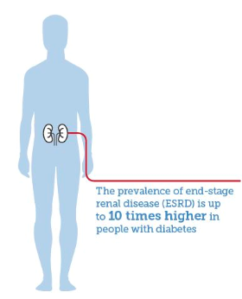
Diabetes and the kidneys¹
Diabetes is one of the leading causes of chronic kidney disease (CKD).
Up to 40% of people with diabetes will develop chronic kidney disease.
More than 80% of cases of end-stage renal disease (ESRD) are caused by diabetes , hypertension or a combination of both.
50 % of dialysis patients have DM.
Both diabetes and CKD are strongly associated with cardiovascular disease (CVD).
The control blood glucose and blood pressure to reduce the risk of kidney disease.
1. IDF Diabetes Atlas - 8th Edition (2017)

Slide 32
Dipeptidyl peptidase IV inhibitor
Sitagliptin(ziptin,….)
Linagliptin(melijent,….) no dose adjustment in RF
Well tolerated, do not cause hypoglycemia
Angioedema/ urticarial and immune-mediated dermatologic effects
Reduced dose with renal disease
Potential risk of acute pancreatities, joint pain

Slide 33
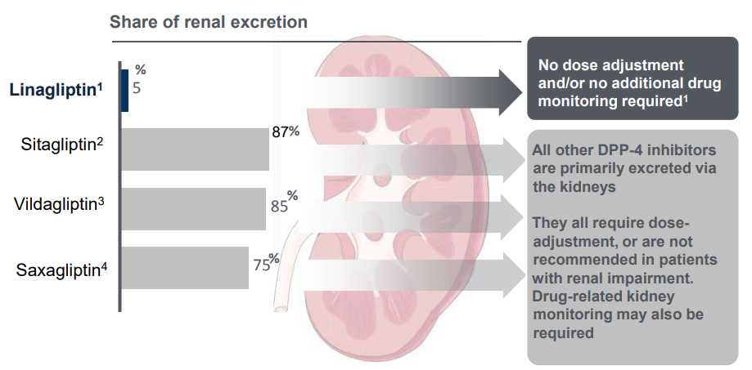
Linagliptin is the only DPP-4 inhibitor which is primarily excreted by gut
1. Linagliptin US prescribing information 2. Drug Metab Dispos. 2007; 35(4): 533–538 , 3. Drug Metab. Dispos. 2009; 37(3):536–544 , 4. Saxagliptin US prescribing information
Notes:
Renal excretion: sitagliptin>vildagliptin>saxagliptin and at last only 5% of linagliptin is excreting by kidney.

Slide 34
Dipeptidyl peptidase IV inhibitor
Dose adjustment in RF
30<Clearance Cr >50………….50mg daily
30> Clearance Cr50 ……………25mg daily

Slide 37
Combination therapy should be considered in patients presenting with A1C level 1.5-2 % above target

Slide 44
SGLT2 inhibitor or GLP-1 RA
For patients with established ASCVD or indicators of high ASCVD risk (such as
Patients 55 years of age with coronary, carotid, or lower-extremity artery stenosis 50% or left ventricular hypertrophy), heart failure, or CKD,
Sitagliptin
linagliptin

Slide 45
insulin therapy
It is common practice to initiate insulin therapy for patients who
present with blood glucose levels 300 mg/dL
or A1C .10% or
if the patient has symptoms of hyperglycemia (i.e., polyuria or polydipsia)
or evidence of catabolism (weight loss)

Slide 49
Moreover, since the absolute effectiveness of most oral medications rarely exceeds 1%,
initial combination therapy should be considered in patients presenting with A1C levels 1.5– 2.0% above target

Slide 50
Conclusion
Patient center approach
Cost is one of the most important barriers
Consider other aspect of treatment, weight management and life style change
Intensification in right time
We need a medical multidisciplinary team

Slide 51
Home Message
Sitagliptin
Efficient HBA1c Reduction
No Hypoglycemia
Good Tolerability
Weight Neutral
Stimulate Insulin Secretion
Glucose dependent Mechanism of Action
Safe in Cardiovascular Disease

